Slide 1
19ECE204
Digital Electronics and Systems
Course objectives
To understand the fundamentals of Boolean Logic and the building blocks of digital circuits
To introduce the abstraction of simple practical problems into Boolean Logic and their efficient
implementation
To introduce the fundamentals of design with combinational and sequential subsystems

Slide 2
Course Outcomes
CO1: Able to frame Boolean equations for solving a simple real-life engineering problem and realize them using gate-level building blocks
CO2: Able to apply minimization techniques for efficient Boolean logic implementation
CO3: Able to realize digital blocks using combinational and sequential subsystems
CO4: Able to design using state machine descriptions for practical real-life engineering problems

Slide 3
CO-PO Mapping
CO/ PO | PO1 | PO2 | PO3 | PO4 | PO5 | PO6 | PO7 | PO8 | PO9 | PO10 | PO11 | PO12 | PSO1 | PSO2
CO1 | 3 | 3 | - | - | - | - | - | - | - | - | - | - | 2 | -
CO2 | 3 | 3 | - | - | - | - | - | - | - | - | - | - | 2 | -
CO3 | 3 | 2 | - | - | - | - | - | - | - | - | - | - | 2 | -
CO4 | 3 | 3 | 2 | - | - | - | - | - | - | - | - | - | 2 | -

Slide 4
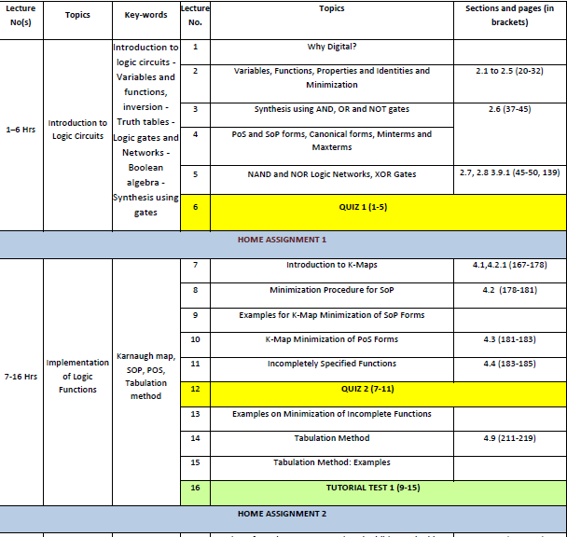

Slide 5
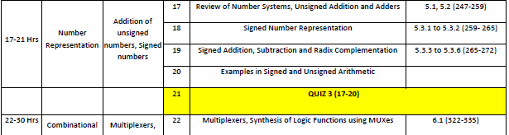
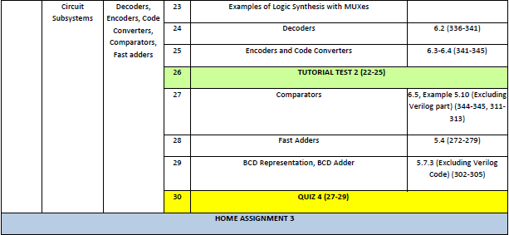

Slide 6
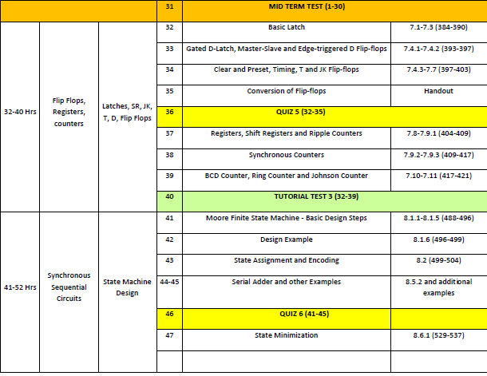

Slide 7
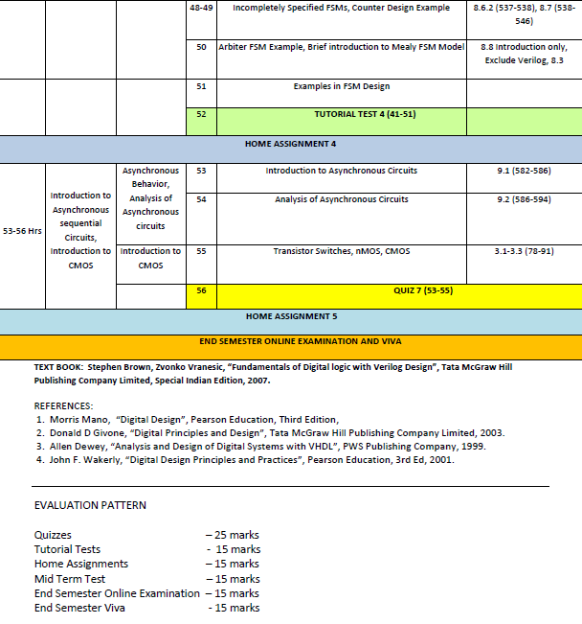

Slide 8
Summary
Course objectives
Course Outcomes
Course Plan
Text book and References
Evaluation Pattern
Why Digital ???

Slide 9
Thank you

